Slide 1
Opportunity Tab, KeyStone Training
Park View Federal Credit Union

Slide 2
When 7K Turns Into a Hay Day!
1 simple refinance grew into 7 new accounts
Referrals are POWERFUL
And now we can track them!

Slide 3
Training Objectives
Efficiently navigate KeyStone interface
Accurately record conversations and referrals onto the Opportunity tab

Slide 4
Training Agenda
Log into KeyStone
Practice Entering Referrals
3 Group practice scenarios
2 Partner practice scenarios
3 Homework (independent) practice scenarios

Slide 5
Dive Into KeyStone!
Scenario #1
Eddie Wentz, Member 00001, stopped in to discuss the possibility of refinancing his auto loan.
Near the end of the conversation, he casually mentions that his daughter is turning 16 in a month and he is thinking about having her apply for a PVFCU credit card.
However, he is not sure if she is old enough or ready for the responsibility. After all, he can hardly believe she is about to get her driver’s license!
What referral opportunity do you recommend?

Slide 6
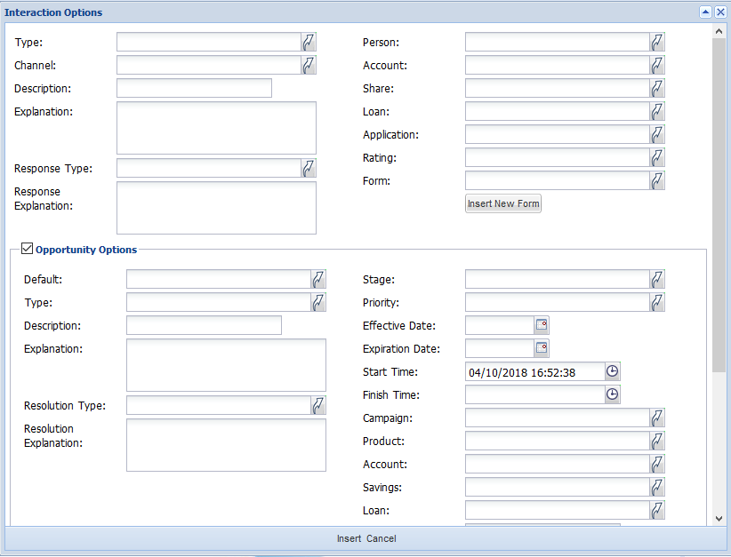
Partner Scenario #1
Member Interaction
Work Que:
Financial Literacy
Referral Opportunity
100
Mr. Anders is struggling to pay bills on time – would benefit from enrolling in automatic payments
User:
Rachel Fiens

Slide 7
Partner Scenario #2
Member Interaction
Work Que:
Mortgage
Referral Opportunity
100
Patricia is looking to purchase a home. Would benefit from discussion with MLA on current rates, and what market she qualifies for
User:
Brad Krisen

Slide 8
Next Steps
Homework Scenarios – Due May 15
3 Practice Referrals onto the Opportunity tab
Feedback will be shared by May 25
Please Ask Questions!

Slide 9
Opportunity Tab, KeyStone Training
THANK-YOU

